Slide 1
Cell signaling overview
Amy Gill
Endo I review – Week 1
10/8/13

Slide 2
Cell signaling basics
Transmitting information to change physiology
Allow cell to respond to environmental changes
Information is encoded as chemical reactions
Proteins and small molecules
Binding and catalytic activity transmit messages
Trigger appropriate changes in cell behavior
Transcription
Enzymatic activity

Slide 3
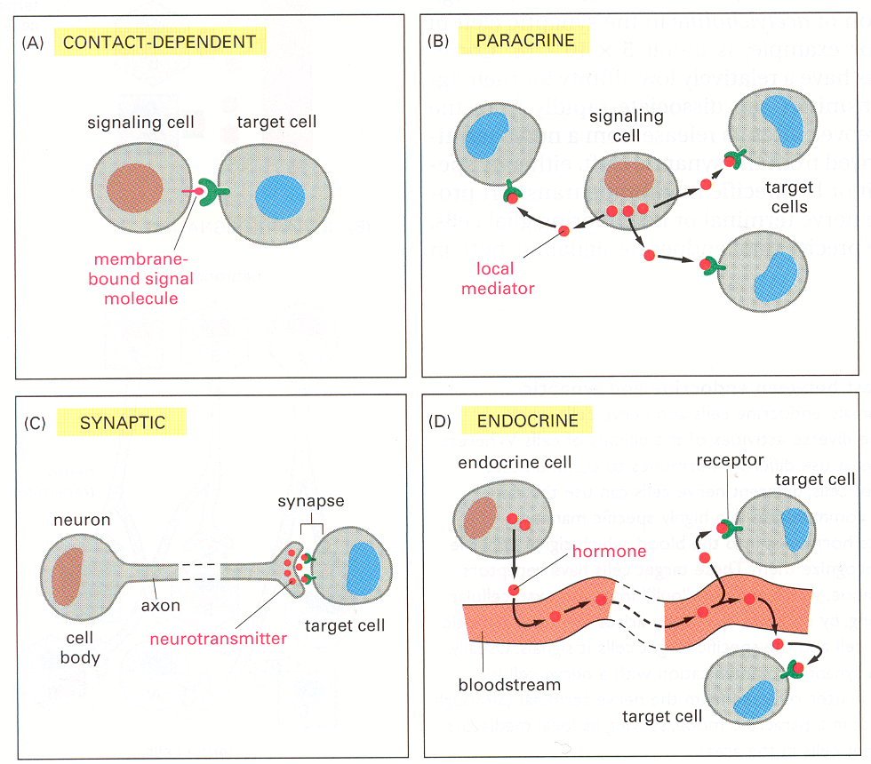
Types of cell-cell communication

Slide 4
Players in cell signaling
Ligand binds receptor
Change in activity → downstream effect
Movement
Conformational change
Physical association
Can affect pathway by changing ligand or receptor
Not a binary switch – dimmer
First messenger: chemical from one cell that signals to another cell
Second messenger: intracellular signal transmitter

Slide 5
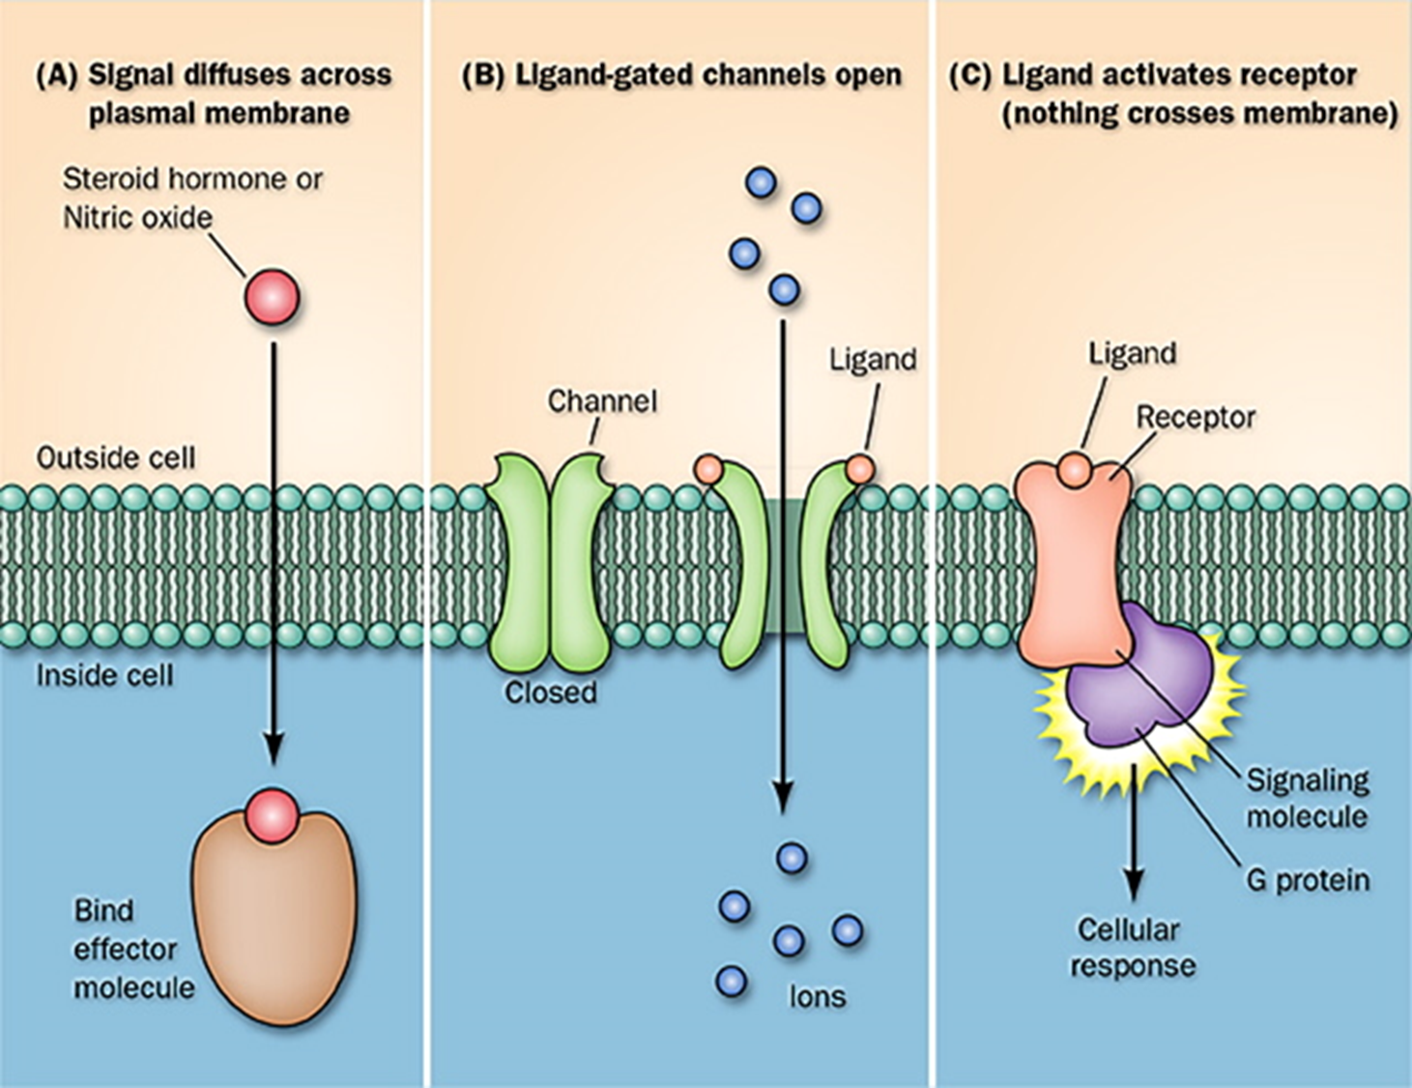
Ligand-receptor paradigms

Slide 6
Key concept: phosphorylation
kinase
P
phosphatase
Even more key concept – activation and inactivation by changing protein state
Phosphorylation does not always mean activation

Slide 7
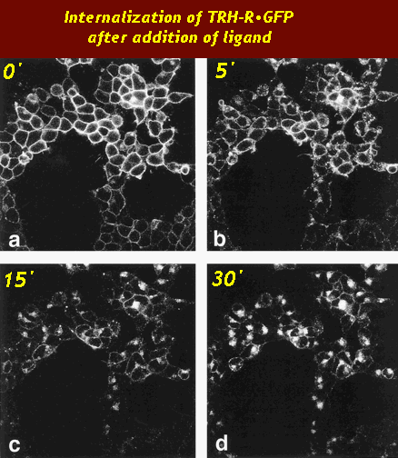
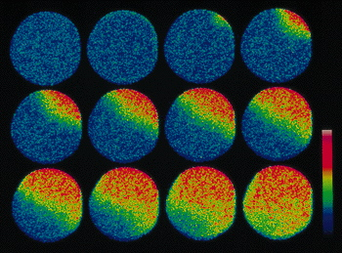
Key concept: spatial effects and movement

Slide 8
Example of a signaling pathway: GPCR
First Messenger
Receptor
α
γ
GPCR
GR, LHR
β
Transducer
G_{s} heterotrimer

Slide 9
Example of a signaling pathway: GPCR
First Messenger
Effector
Adenylyl
Cyclase
Receptor
α
γ
GPCR
GR, LHR
β
Second
Messenger
cAMP
Transducer
ATP
G_{s} heterotrimer
Protein Kinase A
P
Effectors
+

Slide 10
Cell signaling alters organismal physiology
Homeostasis
↑ glucose – beta cell – insulin – IR signaling in target tissues (muscle, fat, liver) – appropriate response - ↓ glucose
Tissue specificity
Insulin does different things in muscle, fat, liver

Slide 11
Ligands can only act where receptors are expressed
Remember:

Slide 12
Concepts in receptor pharmacology

Slide 13
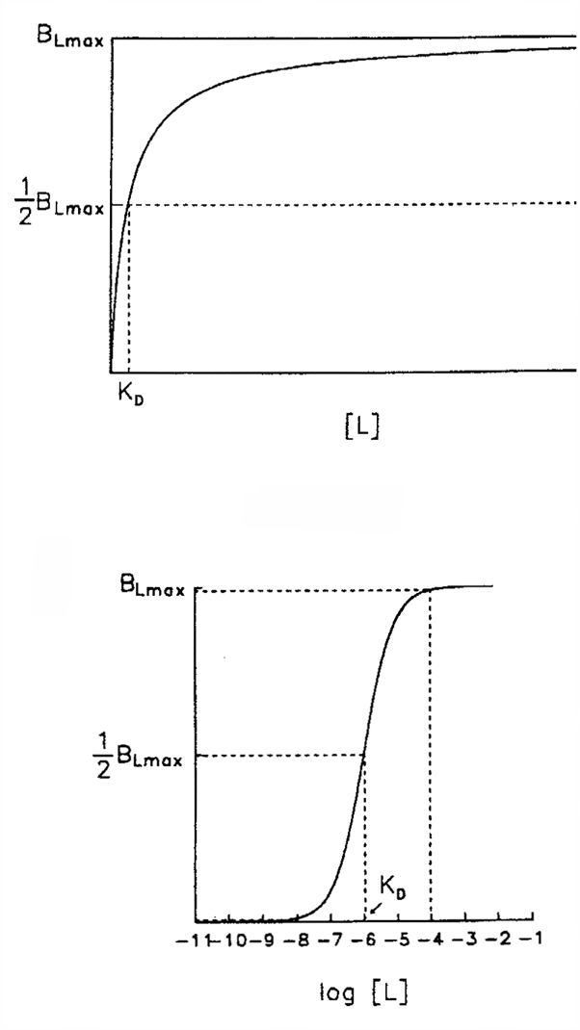
Affinity
How strongly a ligand binds to its receptor
Measured as K_{D}
Dissociation equilibrium constant
Defined as concentration of half maximal binding
High affinity receptor has a low K_{D}
Need less ligand to saturate receptor

Slide 14
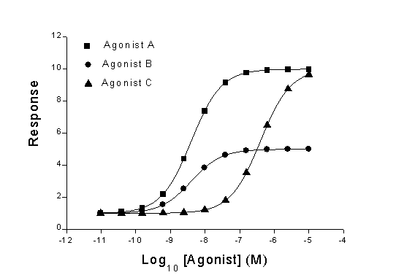
Types of agonists
Maximal activity
Basal activity

Slide 15
Types of agonists
Strong agonist
Weak agonist

Slide 16
Types of agonists
Strong agonist
OR + antagonist

Slide 17
Types of agonists
Partial agonist

Slide 18
Types of agonists
Inverse agonist

Slide 19
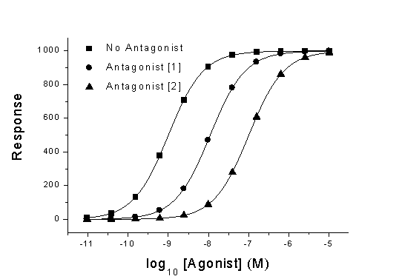
One way to measure antagonist activity: how much agonist required to overcome

Slide 20
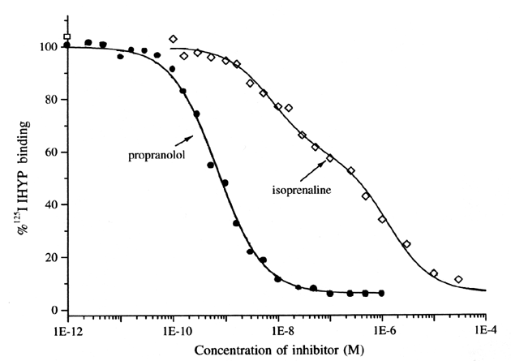
Another way to measure antagonist activity: how much required to overcome agonist

Slide 21
Receptor kinetics explain agonists
Basal activity:
spontaneous activation
R
R*
L
L
LR
LR*
Agonist stabilizes active receptor
Antagonist stabilizes inactive receptor
Partial agonist
likes either form
LRo
inverse agonist permanently disables receptor
3-9

Slide 22
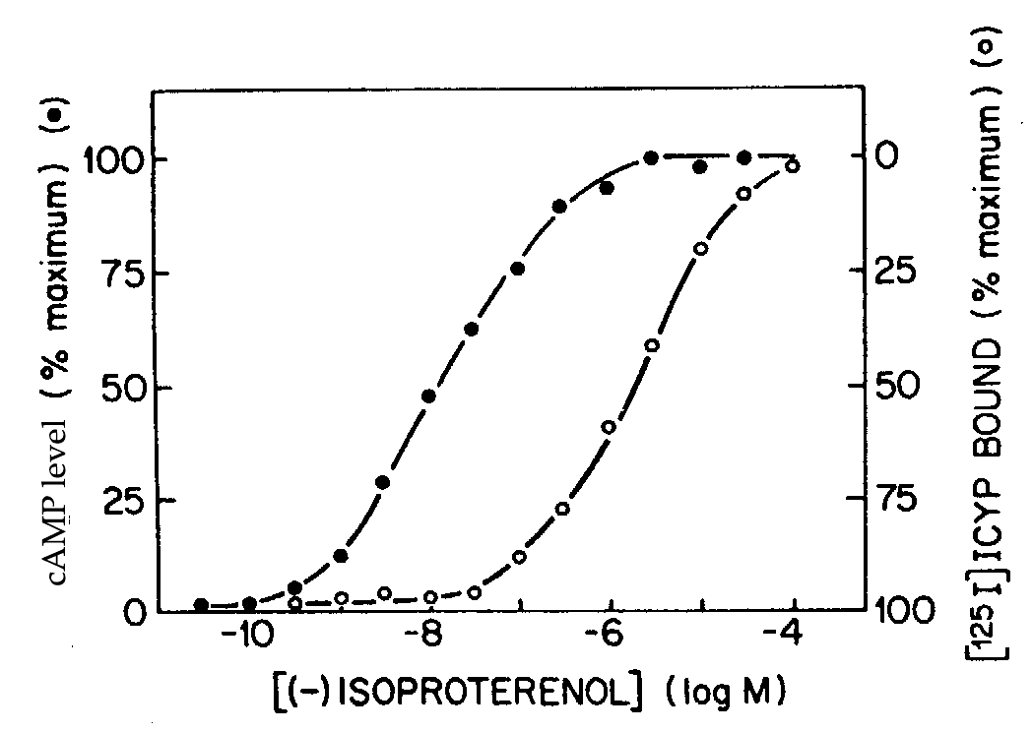
Spare receptors: biological response does not require maximal ligand binding
Controls how easy it is to inactivate or desensitize the system

Slide 23
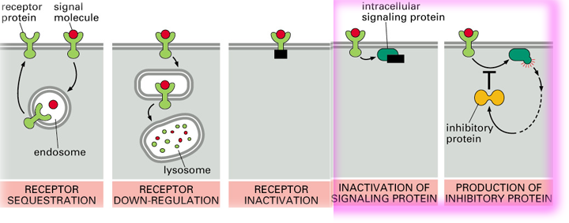
Receptors can be inactivated after responses – prevent repeated or continued signaling
Down-regulation:
Receptor leaves cell surface
Desensitization:
Receptor stays at cell surface but cannot respond to signal

Slide 24
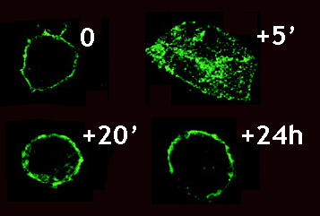
Desensitization and receptor recycling: example of β-adrenergic receptors

Slide 25
Techniques to manipulate protein expression
NEED TO KNOW
Will be used in homework and exam questions
Be sure you understand these – ask for help if you need it
Common techniques in experimental biology

Slide 26
Delivering DNA/RNA to cells
Methods
Transfection
Transient
Stable
Viral infection
Experimental techniques
RNAi knockdown
Overexpression

Slide 27
RNAi knockdown
Small RNAs that are complementary to the mRNA you want to knock down
Binding creates dsRNA
Cell destroys dsRNA, knocking down your mRNA
2 main types
siRNA – transient transfection
shRNA – stable, integrated in host genome
Key points
Knockdown efficiency is variable
Highly sequence specific

Slide 28
Overexpression
Transfect copies of your gene of interest
Transient – put mRNA straight in
Stable – get extra copies to integrate into host genome
Can do different kinds
Endogenous protein
Mutant protein – non-functional or hyperactive
Fusion protein – GFP-tagged, for example

Slide 29
Mouse models to know
Transgenic – overexpress a protein
Knockout – remove part of the gene of interest to make a nonfunctional protein
Knock-in – replace part of the gene of interest to modify protein function

Slide 30
Transgenic mice
Inject DNA into zygotes, screen for gene of interest
Key points
Endogenous gene is still expressed!
Integrates randomly into the genome – could disrupt other genes
Often integrate as multiple copies – gene dosage effects

Slide 31
Knock-in and knockout mice
Homologous recombination to replace endogenous gene

Slide 32
Cre-lox system – method for inducible and tissue-specific knockout
loxP
loxP
Floxed allele

Slide 33
Cre deletes anything between loxP sites
promoter
Cre
Cre

Slide 34
The ROSA/lacZ Cre-lox system
No lacZ transcription
promoter
STOP
lacZ
+
Cre
lacZ
promoter
lacZ
+ Xgal
= Blue

Slide 35
Cre-lox pros and cons
Pros
Tissue specific
Inducible
Cons
Tissue specific might be not totally specific
Inducible might be leaky

